Slide 1
Unit 25
The Mediator and Memento Patterns
Design Patterns
Notes:
Presentation
D3 - undergraduate

Slide 2
The Mediator Pattern
Intent
  Define an object that encapsulates how a set of objects interact. Mediator promotes loose coupling by keeping objects from referring to each other explicitly, and it lets you vary their interaction independently.
Motivation
  Object-oriented design encourages the distribution of behavior among objects. Such distribution can result in an object structure with many connections between objects; in the worst case, every object ends up knowing about every other.
  We can avoid these problems by encapsulating collective behavior in a separate Mediator object. A mediator is responsible for controlling and coordinating the interactions of a group of objects. The mediator serves as an intermediary that keeps objects in the group from referring to each other explicitly. The objects only know the mediator, thereby reducing the number of interconnections.

Slide 3
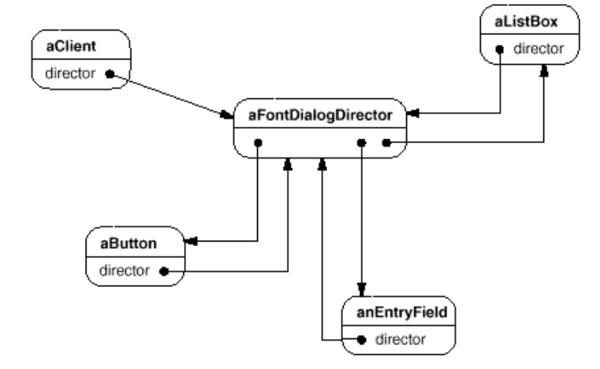
The Mediator Pattern
Applicability
  Use the Mediator pattern when
  a set of objects communicate in well-defined but complex ways. The resulting interdependencies are unstructured and difficult to understand
  reusing an object is difficult because it refers to and communicates with many other objects
  a behavior that's distributed between several classes should be customizable without a lot of subclassing
Notes:
Less cluttered diagrams
Reminder

Slide 4
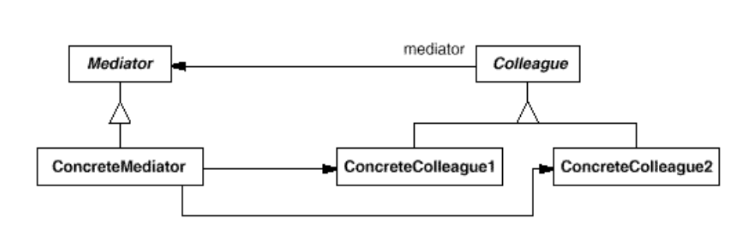
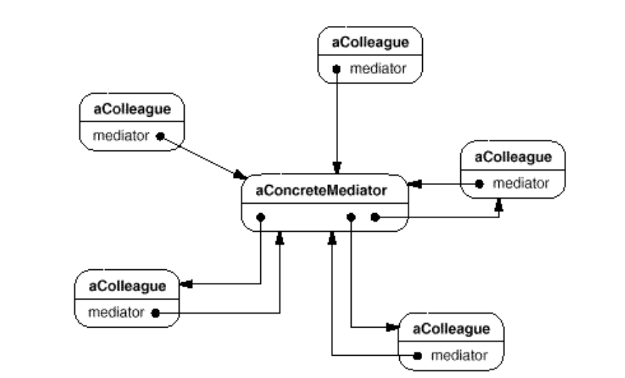
The Mediator Pattern
Structure
  A typical object structure might look like this
Notes:
Less cluttered diagrams
Reminder

Slide 5
The Mediator Pattern
Participants
  Mediator
    defines an interface for communicating with Colleague objects
  ConcreteMediator
    implements cooperative behavior by coordinating Colleague objects
    knows and maintains its colleagues
  Colleague classes
    each Colleague class knows its Mediator object
    each colleague communicates with its mediator whenever it would have otherwise communicated with another colleague
  A typical object structure might look like this
Notes:
Less cluttered diagrams
Reminder

Slide 6
The Mediator Pattern
Collaborations
  Colleagues send and receive requests from a Mediator object. The mediator implements the cooperative behavior by routing requests between the appropriate colleague(s)
Consequences
  The Mediator pattern has the following benefits and drawbacks:
  It limits subclassing
  It decouples colleagues
  It simplifies object protocols
  It abstracts how objects cooperate
  It centralizes control
  A typical object structure might look like this
Notes:
Less cluttered diagrams
Reminder

Slide 7
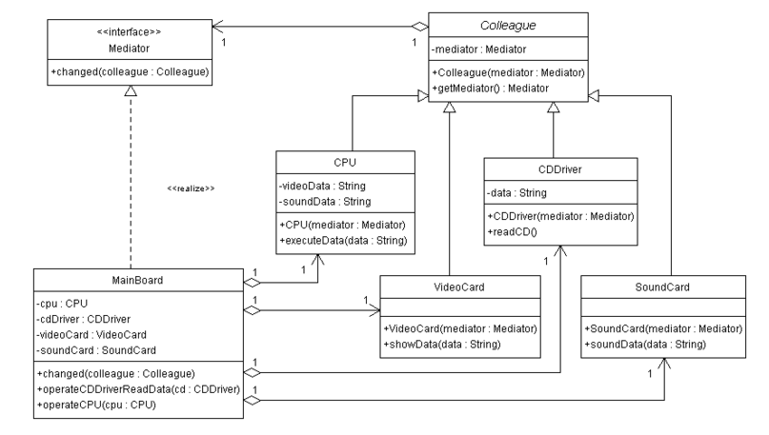
Mediator Pattern Example
Suppose you had a PlainTextDocument class as follows:
  public class PlainTextDocument {
    ...
    public void printPage (Page page) {
      printPlainTextHeader(); // Unique to PlainTextDocument
      System.out.println(page.body());
      printPlainTextFooter(); // Unique to PlainTextDocument
    }
    ...
  }
Notes:
OH with complete chart
Zimmer’s Gamma and Gamma’s Gamma not the same

Slide 8
The Memento Pattern
Intent
  Without violating encapsulation, capture and externalize an object's internal state so that the object can be restored to this state later
Also Known As
  Token
Motivation
  Sometimes it‘s necessary to record the internal state of a object. This is required when implementing checkpoints and undo mechanisms that let users back out of tentative operations or recover from errors. You must save state information somewhere so that you can restore objects to their previous states. But objects normally encapsulate some or all of their state, making it inaccessible to other objects and impossible to save externally. Exposing this state would violate encapsulation, which can compromise (危害) the application's reliability and extensibility
Notes:
Less cluttered diagrams
Reminder

Slide 9
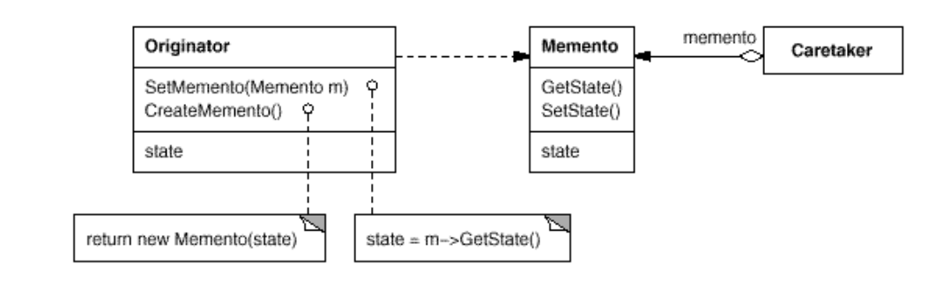
The Memento Pattern
  We can solve this problem with the Memento pattern. A memento is an object that stores a snapshot (快照) of the internal state of another object — the memento’s originator (原发器)
Applicability
  Use the Memento pattern when
  a snapshot of (some portion of) an object's state must be saved so that it can be restored to that state later, and
  a direct interface to obtaining the state would expose implementation details and break the object's encapsulation
Structure
Notes:
Less cluttered diagrams
Reminder

Slide 10
The Memento Pattern
Participants
  Memento
    stores internal state of the Originator object. The memento may store as much or as little of the originator's internal state as necessary at its originator's discretion
    protects against access by objects other than the originator. Mementos have effectively two interfaces. Caretaker sees a narrow interface to the Memento—it can only pass the memento to other objects. Originator, in contrast, sees a wide interface, one that lets it access all the data necessary to restore itself to its previous state. Ideally, only the originator that produced the memento would be ermitted to access the memento's internal state
  Originator
    creates a memento containing a snapshot of its current internal state
    uses the memento to restore its internal state
  Caretaker
    is responsible for the memento's safekeeping
    never operates on or examines the contents of a memento
Notes:
Less cluttered diagrams
Reminder

Slide 11
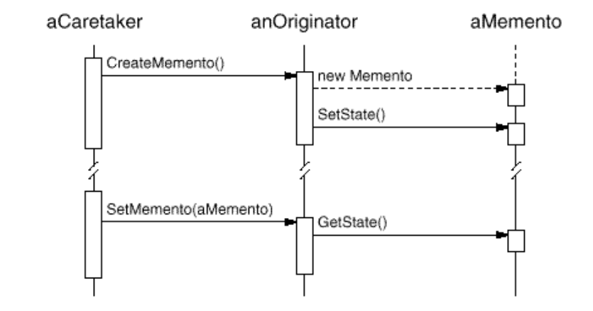
The Memento Pattern
Collaborations
  A caretaker requests a memento from an originator, holds it for a time, and passes it back to the originator, as the following interaction diagram illustrates:
Notes:
Less cluttered diagrams
Reminder

Slide 12
The Memento Pattern
Consequences
  The Memento pattern has several consequences:
  Preserving encapsulation boundaries
  It simplifies Originator
  Using mementos might be expensive
  Defining narrow and wide interface
  Hidden costs in caring for mementos
Notes:
Less cluttered diagrams
Reminder

Slide 13
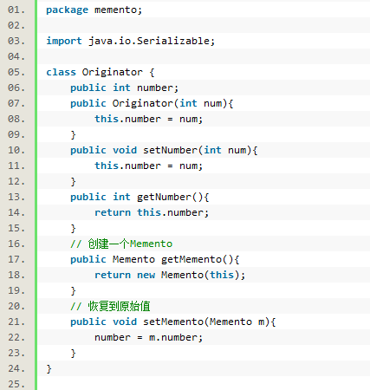
The Memento Pattern Example
Notes:
Less cluttered diagrams
Reminder

Slide 14
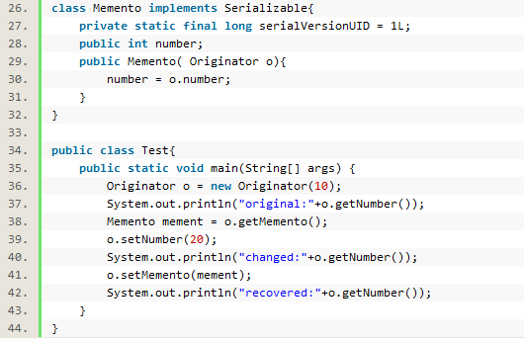
The Memento Pattern Example
Notes:
Less cluttered diagrams
Reminder

Slide 15
Conclusion

